Slide 1
Sheet Metal Estimation File Training Template
Note: This Document is classified as "CONFIDENTIAL"
Form 03101-07_Rev.00_Effective Date: 01-Jul-2019

Slide 2
Capturing DP BOM
Detail Part number identification from Configuration BOM if the deliverable is Assembly.
Refer to the part category column for Detail parts & identify Shop details by referring engineering data.
S.no | Module | Deliverable Part number | level | Part number | Part description | Qty/Assy | Qty/ss | Part Category | Shop
1 | A320 CEO/NEO | D53137394 000 | 0 | D53137394 000 | ENS PAN SUP EQUIPE | 1 | 1 | Deliverable | Assembly
2 | A320 CEO/NEO | D53137394 000 | 1 | D53113450202 | PLANCHER CASE TRAIN | 1 | 1 | Detail part | TBD
3 | A320 CEO/NEO | D53137394 000 | 1 | D53113551002 | TRAVERSE EQUIP C12 | 2 | 2 | Sub Assembly | Assembly
4 | A320 CEO/NEO | D53137394 000 | 2 | D53113850200 | TRAVERSE C10 11 12 | 1 | 2 | Detail part | TBD
5 | A320 CEO/NEO | D53137394 000 | 2 | D53113881200 | TE | 3 | 6 | Detail part | TBD
6 | A320 CEO/NEO | D53137394 000 | 2 | PQ10010-020-00 | MASTIC D'ETANCHEITE | 0 | 0 | Consumable | Consumable
7 | A320 CEO/NEO | D53137394 000 | 2 | ASNA2050DEJ040 | SOLID RIVET | 0 | 0 | Standard part | Standard part
8 | A320 CEO/NEO | D53137394 000 | 2 | ASNA2050DXJ040 | SOLID RIVET | 40 | 80 | Standard part | Standard part
9 | A320 CEO/NEO | D53137394 000 | 1 | D53113552002 | TRAVERSE EQUIP C11 | 1 | 1 | Sub Assembly | Assembly
10 | A320 CEO/NEO | D53137394 000 | 2 | D53113850200 | TRAVERSE C10 11 12 | 1 | 1 | Detail part | TBD
11 | A320 CEO/NEO | D53137394 000 | 2 | D53113921200 | TE | 3 | 3 | Detail part | TBD
12 | A320 CEO/NEO | D53137394 000 | 2 | PQ10010-020-00 | MASTIC D'ETANCHEITE | 0 | 0 | Consumable | Consumable
13 | A320 CEO/NEO | D53137394 000 | 2 | ASNA2050DEJ040 | SOLID RIVET | 0 | 0 | Standard part | Standard part
14 | A320 CEO/NEO | D53137394 000 | 2 | ASNA2050DXJ040 | SOLID RIVET | 40 | 40 | Standard part | Standard part
15 | A320 CEO/NEO | D53137394 000 | 1 | D53113554003 | TRAVERSE EQUIP C13 | 1 | 1 | Sub Assembly | Assembly
16 | A320 CEO/NEO | D53137394 000 | 2 | D53113854200 | TRAVERSE C13 | 1 | 1 | Detail part | TBD
17 | A320 CEO/NEO | D53137394 000 | 2 | D53113921200 | TE | 1 | 1 | Detail part | TBD
18 | A320 CEO/NEO | D53137394 000 | 2 | D53113862200 | CORNIERE | 2 | 2 | Detail part | TBD
19 | A320 CEO/NEO | D53137394 000 | 2 | D53113883200 | CORNIERE | 4 | 4 | Detail part | TBD
20 | A320 CEO/NEO | D53137394 000 | 2 | D53113882200 | CORNIERE | 1 | 1 | Detail part | TBD
21 | A320 CEO/NEO | D53137394 000 | 2 | D53113884200 | CORNIERE | 1 | 1 | Detail part | TBD
22 | A320 CEO/NEO | D53137394 000 | 2 | PQ10010-020-00 | MASTIC D'ETANCHEITE | 0 | 0 | Consumable | Consumable

Slide 3
Capturing DP BOM
Shop Identification(Sheet metal , Machining, Tube Shop, Non Metallic Buy, Metallic buy, Vendor part..etc. ) & part requirements(Material, Size, Weight, manufacturing process, Special process..etc) from engineering data received(Part List,2D drawing & 3D Model) in the DP BOM.
S.no | Part number | Name | Part Category | Shop | Material Type | Material Alloy | RM Input | Material spec | Alternate Material spec | Extrusion/Formed Section Spec | Extrusion Standard Weight (Kg/M) | Make From | Initial Temper | Final Temper
1 | D53113450202 | PLANCHER CASE TRAIN | Detail part | Machining | Aluminium | 7175 | Plate | ABS5064A030 | ABS5064A040 |  |  |  | T7351 | T7351
2 | D53113880200 | CORNIERE | Detail part | Sheetmetal | Aluminium | 2024 | Sheet | ASNA60988628 |  |  |  |  | T4 | T4
3 | D53918282200 | SUPPORT EQUIPE | Detail part | Non-metallic | Polyamide | Polyamide 6.6 |  | PQ10058-003-00
S.no | Part number | Name | Part Category | Shop | PL Length mm | PL Width mm | PL Thickness mm | PL OD mm | PL ID mm | Finished Part Length mm | Finished Part Width mm | Finished Part Thickness mm | Finished Part OD mm | Finished Part ID mm | Final Part Weight (Kgs) | Number Of Holes | Hole dia in mm | No of Holes on formed surfaces | No of Bends | Bend Radius (mm) | Cutout Perimeter mm
1 | D53113450202 | PLANCHER CASE TRAIN | Detail part | Machining | 2900 | 1150 | 30.00 |  |  | 2750 | 1026 | 21 |  |  | 18.25
2 | D53113880200 | CORNIERE | Detail part | Sheetmetal | 50 | 50 | 1.60 |  |  | 45 | 26.6 | 1.60 |  |  | 0.006 | 2 |  |  | 1 | 4
3 | D53918282200 | SUPPORT EQUIPE | Detail part | Non-metallic |  |  |  |  |  | 34 | 29 | 20
S.no | Part number | Name | Part Category | Shop | Technology Make/Buy | Manufacturing technology | Major Technology | Complexity | Special process code | Spl process description | Spl process description | Special process Make/Buy | Vendor Details | IMP notes/Remarks | Query Remarks | Status
1 | D53113450202 | PLANCHER CASE TRAIN | Detail part | Machining | Make | 5A VMC 4.0m Softmetal (Milling & Drilling) | 5A VMC 4.0m Softmetal | Complex | A08+A01 | TSA+ Primer+to pcoat | TSA per AIPS 02-01-003+Primer per A00710050+Top coat per A00710050 | Make |  |  |  | Completed
2 | D53113880200 | CORNIERE | Detail part | Sheetmetal | Make | 3A Routing+BP-2 | Brake press | Simple | A08 | TSA+ Primer+to pcoat | TSA per AIPS 02-01-003+Primer per A00710050+Top coat per A00710050 | Make |  |  |  | Completed
3 | D53918282200 | SUPPORT EQUIPE | Detail part | Non-metallic | Buy | Non Metallic Buy | Non Metallic Buy | - | 000 | No protection | No protection | No protection |  |  |  | Completed

Slide 4
Taking technical details from Bill of material
Mapping below points from DP BOM to Sheetmetal estimation template
Consider all the shop identified as “sheet metal” in DP BOM
Part numbers
Part description
Material type, alloy and material specification
Initial and final temper condition
Mapping dimensions from Part list(Length, width, & Thickness)
Mapping of finished dimensions(Length, width & Thickness)
Holes, cutout, bends & Bend radius
Manufacturing process, major technology, special process codes and description with Specification.

Slide 5
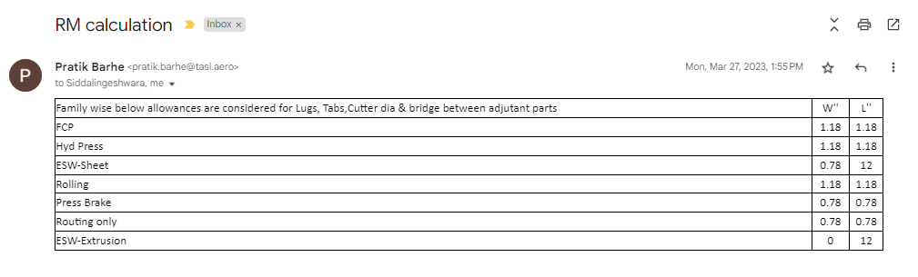
Raw material allowance
As received from Engineering team.
Allowance to be considered as per estimation workout.
Part family wise alloance considered in Estimation | Width in mm | Length in mm | Remarks
FCP | 30 | 30
Hyd Press | 30 | 30
ESW-Sheet | 30 | 400
Rolling | 30 | 30
Press Brake | 30 | 30
Routing only | 30 | 30
ESW-Extrusion | 0 | 400
Sheet stretch forming | 100 | 700 | 700 mm to considered on the Jaw holding side irrespective of length & width

Slide 6
Approximate MHR for Machines
Machines List _ Test | MHR ($/Hr)
3A Router Flexicam 3.5M_TASL | 43
3A Router Flexicam 3.5M_TSAL | 43
3A-Laser Cutting | 90
5A Routing Flexicam 8.0M | 90
5A Router Thermwood | 65
Automatic deburr | 30
Nibbler Trumpf | 68
Brake Press Durma 3.0M | 28
Brake Press Cincinnati 3.0M | 28
Hydraulic Press Pacific 0.5M | 35
Hydraulic Press Electro Pneumatic 0.5M | 35
Hydraulic Press 1.0M | 55
Hydraulic Press 2.0M | 75
Flexiform Avure 2.0M | 298
Flexiform Triform 2.5M | 250
Rolling Davi 3.5M | 69.73
Rolling Davi 2.7M | 69.73
Conical Rolling | 69.73
Rolling 360° | 69.73
Hand router | 10
Hand Forming | 10
Barani Rubber Press 4M | 125
Hand Trim | 10
Hand Drill | 10
Modig | 60
Manual Deburr | 10
Shearing | 30
Machines List _ Test | MHR ($/Hr)
Bandsaw Machine | 3.64
Titanium 5A-Milling | 200
Check and Hand Straightening | 12
Ti Hot Forming Press | 150
Sheet Flattening Machine | 30
Sheet Stretch Forming Machine | 350
Ext Stretch wrap 3M Triform 60T | 180
3A VMC 0.5M Aluminium | 23
Profile roll | 200
Ext Stretch wrap 3M Triform 28T | 150
Quality Inspection | 15
5A VMC 4.0M Aluminium | 142
MMS | 250
Shape correction | 10
Al Hot forming | 65
Modig | 92
Mechanicl Press 0.5M | 30
Hydraulic Press New | 55
5A VMC 1.0M Hardmetal | 60
Profile Roll Forming | 70
Barani-Hot Forming | 55
5A Routing Hardmetal | 120
Hydraulic Press 3.0M_New | 75
5A Routing Flexicam 3.0M | 75

Slide 7
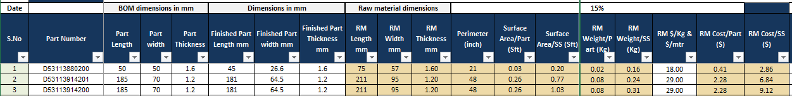
RM Estimation
RM Length/width mm= Finished Part Length+30mm/width 30mm
Perimeter= 2* (Length + Width)+Perimeter of cutout
Surface Area= 0.00001076 * 2 * (Length*Width + Width*Thickness+ Length*Thickness)
RM Weight/Part = RM Length*RM Width*RM Thickness* Scrap Allowance*Density of Material
=RM Length*Extrusion Standard Weight/Length [Extrusion]
= RM Length*Formed Section Standard Weight/Length [Formed section]
Note : Scrap Allowance= 1.15
RM Cost/Part= RM Part Weight*Cost/Kg.
Material | Density (gm/CC)
Aluminium | 2.850
Steel | 7.820
Titanium | 4.500
Nickel alloy | 8.190
Copper | 8.950
ETP Copper | 8.92
DHP Copper | 8.94
Al-Magnesium | 4.100
Beryllium copper | 8.25
Brass | 8.58
Phosphor Bronze | 8.86
Aluminium Bronze | 7.700
Nickel aluminium bronze | 7.64
Aluminium Silicon Bronze | 7.21
Cobalt Alloy | 8.86

Slide 8
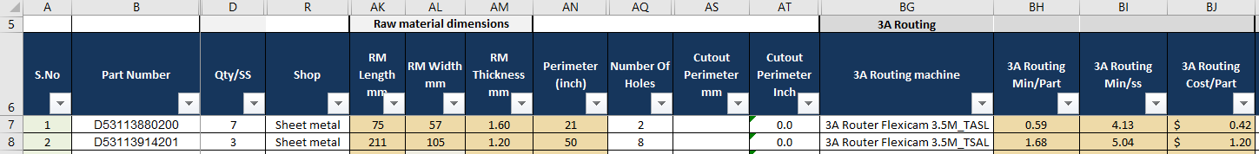
Manufacturing Process Time and Cost Estimation
Technology-3A Routing
Formula in Column ‘’BH”
IF($B7<>"",IF(BF7="Make",IF(ISNUMBER(SEARCH("Flexicam",BG7)),(AN7/(140*35%))+AQ7*5/60,IF(ISNUMBER(SEARCH("Thermwood",BG7)),(AN7/(32*50%))+AQ7*20/60,0)),0),"")
3A Routing Min/Part = Perimeter/(140"*35%) + (No. of holes*5)/60
Note: Considering 35% of machine Feed rate 140 inches/min and Time taken for drilling one hole is 5 secs
3A Routing Min/SS = 3A Routing Min/Part*(Qty/SS)
3A Routing Cost = (3A Routing Min/60) * MHR

Slide 9
Manufacturing Process Time and Cost Estimation
Technology-5A Routing
Formula in Column BL
=IF($B7<>"",IF(BF7="Make",IF(ISNUMBER(SEARCH("5A Routing Flexicam",BK7)),(60/(MIN((D7*Q7),50)))+5+((AN7*1)/(70*50%))+(5/60)*AR7,IF(ISNUMBER(SEARCH("5A Router Thermwood",BK7)),(40/(D7*Q7))+3+((AN7*1)/(32*50%))+(5/60)*AR7,0)),0),"")
5A Routing Min = 60/(Qty/SS * EBQ) +Part setup + Perimeter/(70*50%) + (No. of holes*5)/60
Note: Considering 60Min Setup time, Considering 50% of machine Feed rate 70 inches/min and Time taken for drilling one hole is 5 secs
5A Routing Min/SS = 5A Routing Min/Part*(Qty/SS)
5A Routing Cost = (5A Routing Min/60) * MHR

Slide 10
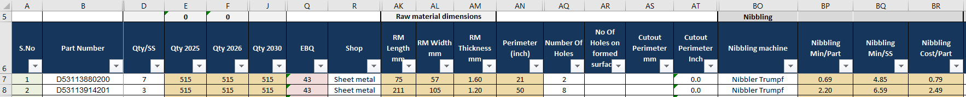
Manufacturing Process Time and Cost Estimation
Technology-Nibbling
Formula in Column BP
=IF($B7<>"",IF(BF7 ="Make",IF(ISNUMBER(SEARCH("Nibbler",BO7)),((AN7)/(96*60%))+(AQ7)*10/60,0),0),"")
Nibbling Min/Part = Perimeter/(96*60%) + (No. of holes*10)/60
Note: Considering 60% of machine Feed rate 96 inches/min and Time taken for drilling one hole is 10 secs
Nibbling Min/SS = Nibbling Min/Part*(Qty/SS)
Nibbling Cost = (Nibbling Min/60) * MHR

Slide 11
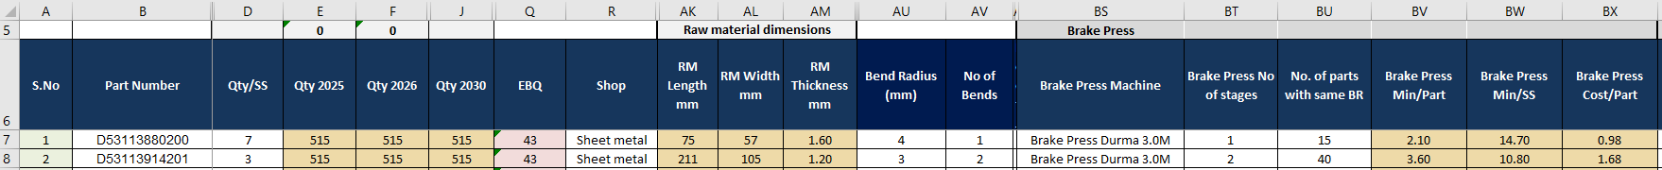
Manufacturing Process Time and Cost Estimation
Technology- Brake Press
Brake Press no. of stages = no. of Bends
Formula in column BU = COUNTIFS(BS:BS,$BS7,AU:AU,$AU7)
Formula in Column BV
=IF($B7<>"",IF(BF7="Make",IF(ISNUMBER(SEARCH("Brake Press",BS7)),((1.5*BT7)+(30/MIN((BU7*D7*Q7),50))),0),0),"")
Break Press Min = 1.5 * Brake Press No of stages + 30/(No of Parts with same bend radius and same machine*Qty/SS * EBQ)
Note: Considering 30Min Setup time and 1.5 mins Single stroke time
Brake Press Min/SS = Brake Press Min/Part*(Qty/SS)
Break Press Cost = (Break Press Min/60) * MHR

Slide 12
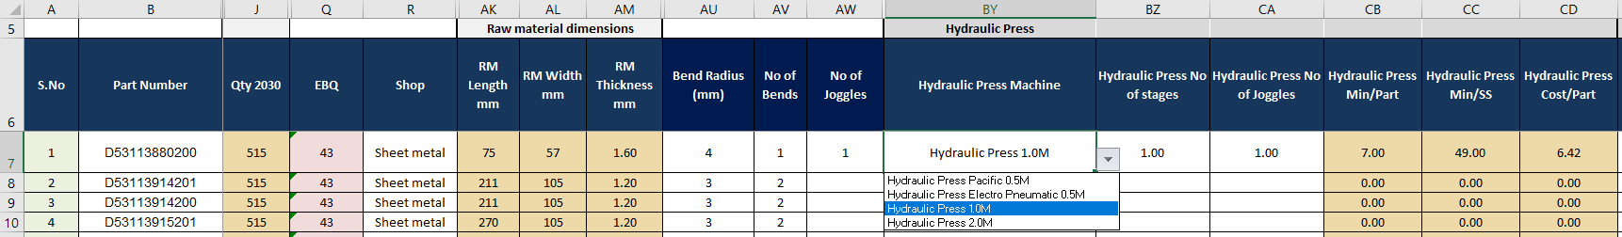
Manufacturing Process Time and Cost Estimation
Technology- Hydraulic Press
Formula in Column CB
=IF($B7<>"",IF(BF7="Make",IF(ISNUMBER(SEARCH("Hydraulic Press",BY7)),(50*BZ7)/(MIN(Q7*D7,50))+(3*BZ7)+(3*CA7),0),0),"")
Hydraulic Press Min = 50*No of setups/(Qty/SS * EBQ)+ 3 * No of stages+3*No. of Joggles
Considering 50Min Setup time and 3 mins Single stroke time
If Part requires 2 Setups(Forming + Re-stricking) then No. of tools required will be 2.
Hence Setup time will be 50min*2(Setting up Forming tool + Setting up Re-Stricking tool)
Hydraulic Press Min/SS = Hydraulic Press Min/Part*(Qty/SS)
Hydraulic Press Cost = (Hydraulic Press Min/60) * MHR

Slide 13
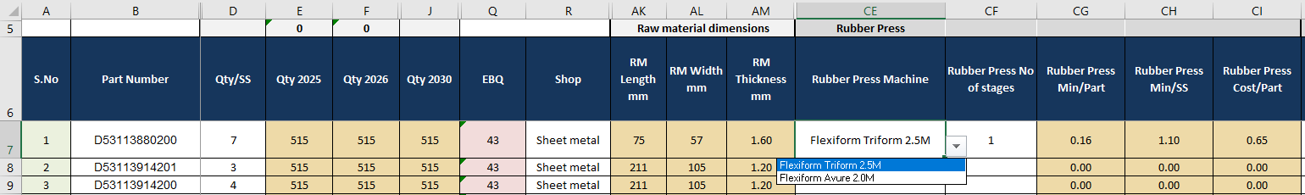
Manufacturing Process Time and Cost Estimation
Technology- Rubber Press
Formula in Column CG
=IF($B7<>"",IF(BF7="Make",IF(ISNUMBER(SEARCH("Flexiform Avure",CE7)),(40/(4*((2232*25.4*25.4)/((AK7+6*25.4)*(AL7+6*25.4)))))+(2/(2232*25.4*25.4)/((AK7+6*25.4)*(AL7+6*25.4)))+(IF((AK7+6*25.4)<=500,1,IF((AND((AK7+6*25.4)>500,(AK7+6*25.4)<1000)),1.5,IF((AK7+6*25.4)>1000,2,0)))/2)*CF7,IF(ISNUMBER(SEARCH("FlexiformTriform",CE7)),(((((AK7+150)*(AL7+150))/(2400*500*0.7))*((40/30)+1.5))*CF7),0))),"“)
Rubber Press Min = [(Setup time/(Batch Size*No. of parts per tray))+(Cycle time/No. of parts per tray)+(Unit time based on size/No. of persons per tray)]* No.of Stages
Note:
Setup time=40Mins, Batch Size=4, Cycle time= 2mins, No.of Personal per Tray=2
No.of Parts per tray= Tray Size/Part Size
Unit Time= 1 for Length<500mm, 1.5 for 500<Length<1000mm, 2.5 for 1000<Length
Rubber Press Min/SS = Rubber Press Min/Part*(Qty/SS)
Rubber Press Cost = (Rubber Press Min/60) * MHR

Slide 14
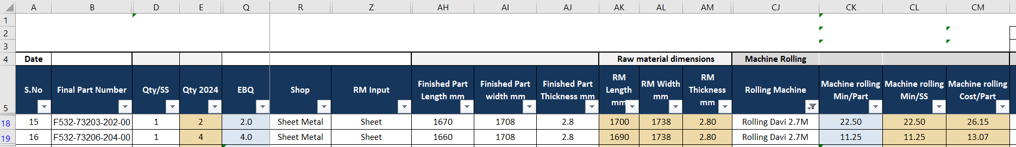
Manufacturing Process Time and Cost Estimation
Technology- Machine Rolling
Formula in Column CK
=(45/(MIN(Q18*D18,40))+(AK18/400)*IF(AJ18<1.9,2,IF(AJ18>1.9<2.9,3,IF(AJ18>2.9,4,0))))
Machine Rolling Min/Part= 45min(Setup time)/(Batch Qty*Qty/SS)
+(RM Part Length/(400mm/Min(Feed rate))*No. of passes(If thickness>1.9<2.9mm=3 Passes
& Thickness>2.9mm=4 Passes)
Machine Rolling Min/SS = Machine Rolling Min/Part*(Qty/SS)
Machine Rolling Cost = ((Machine Rolling Min/Part)/60) * MHR

Slide 15
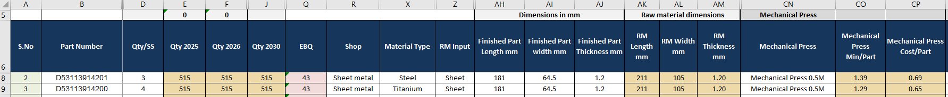
Manufacturing Process Time and Cost Estimation
Technology- Mechanical Press 0.5M
Formula in Column CO
=IF($B8<>"",IF(BF8="Make",IF(ISNUMBER(SEARCH("Mechanical Press 0.5M",CN8)),((50/(D8*Q8))+1),0),0),"")
Setup time(30min/(Qty/SS*Batch Qty))+Run Time(1 Min)
Mechanical Press 0.5M Cost/Part = ((Mechanical Press 0.5M Min/Part)/60) * MHR
Criteria
Hard Metal(Steel/Titanium/Inconel..etc)
Finished Part Length < 450mm & Part Thickness to be <=1.2mm

Slide 16
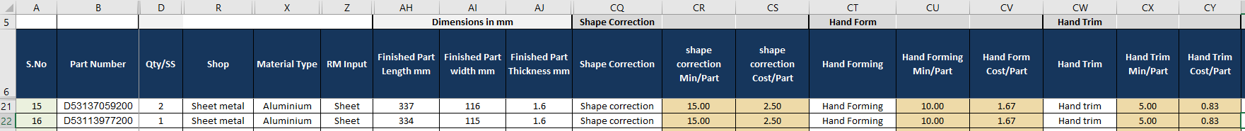
Manufacturing Process Time and Cost Estimation
Technology- Shape Correction, Hand Forming, Hand Trim
Formula in Column CR(Shape Correction)
=IF($B21<>"",IF(BF21="Make",IF(ISNUMBER(SEARCH("Shape correction",CQ21)),IF(AH21<500,15,IF(AH21<1000,20,30)),0),0),"")
Shape Correction Min = 15min (Finished Part length<500), 20min (if Finished Part length<1000), 30min (if Finished Part length>=1000)
Shape correction to be considered for Rubber Press parts.
Formula in Column CU(Hand Forming)
=IF($B21<>"",IF(BF21="Make",IF(ISNUMBER(SEARCH("Hand Form",CT21)),IF(AH21<500,10,IF(AH21<1000,15,30)),0),0),"")
Hand Forming min = 10min (Finished Part length<500), 15min (if Finished Part length<1000), 30min (if Finished Part length>=1000)
Formula in Column CX(Hand Trim)
=IF($B21<>"",IF(BF21="Make",IF(ISNUMBER(SEARCH("Hand Trim",CW21)),IF(AH21<500,5,IF(AH21<1000,15,35)),0),0),"")
Hand Trimming min = 5min (Finished Part length<500), 15min (if Finished Part length<1000), 35min (if Finished Part length>=1000)

Slide 17
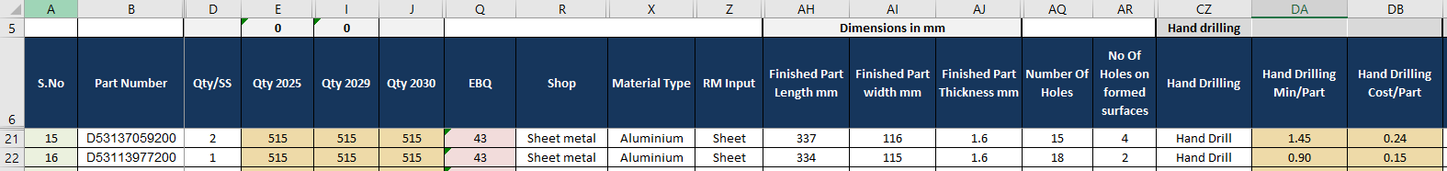
Manufacturing Process Time and Cost Estimation
Technology- Hand Drill
Formula in Column DA
=IF($B21<>"",IF(BF21="Make",IF(ISNUMBER(SEARCH("Hand Drill",CZ21)),((10/(D21*Q21))+(AR21*20/60)),0),0),"")
Hand Drilling Min = 10min/(Qty/SS * EBQ) + No Of Holes on formed surfaces*20/60
Hand Drilling Cost = (Hand Drilling Min/Part)/60) * MHR

Slide 18
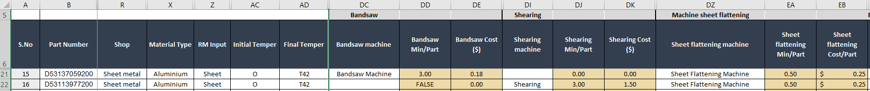
Manufacturing Process Time and Cost Estimation
Technology- Bandsaw Machine, Shearing Machine,Sheet Flattening Machine
For Extrusion & Formed Sections.
Band Saw Min = 3 Min[Standard]
Band Saw Cost = (Band Saw Min/Part)/60)*MHR
Shearing Min = 3 Min[Standard]
Shearing Cost = (Shearing Min/Part)/60)*MHR
Sheet flattening process to be considered for Aluminium(Sheet) parts having Heat treatment( Solutionising )
Sheet Flattening Machine Min = 0.5 Min[Standard]
Sheet Flattening Machine Cost = (Sheet Flattening Machine Min/Part)/60)*MHR

Slide 19
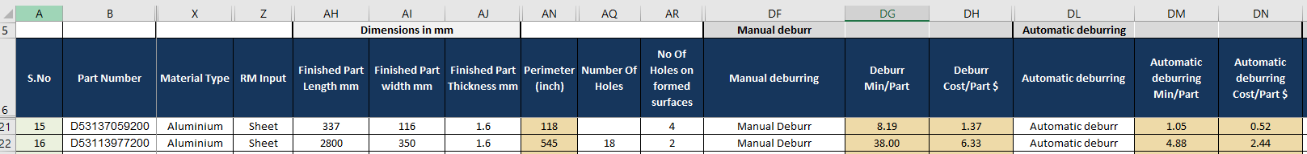
Manufacturing Process Time and Cost Estimation
Technology- Manual Deburr, Automatic Deburr
Formula in Column DG
=IF($B21<>"",IF(BF21="Make",IF(ISNUMBER(SEARCH("Manual Deburr",DF21)),((AN21*4)+((AQ21+AR21)*5))/60,0),0),"")
Manual deburring of parts after 5A Routing/3A VMC & 5A VMC
Manual Deburring Min = (Perimeter*4 + Number Of Holes * 5)/60
Manual Deburring Cost = (Manual Deburring Min/Part)/60)*MHR
Formula in Column DM
=IF($B21<>"",IF(BF21="Make",IF(ISNUMBER(SEARCH("Automaticdeburr",DL21)),((AN21*0.5)+((AQ21+AR21)*1))/60,0),0),"")
Automatic deburring of parts after 3A Routing
Automatic Deburring Min = (Perimeter *0.5sec +(Holes)*1sec)/60
Automatic Deburring Cost = (Automatic Deburring Min/Part)/60)*MHR

Slide 20
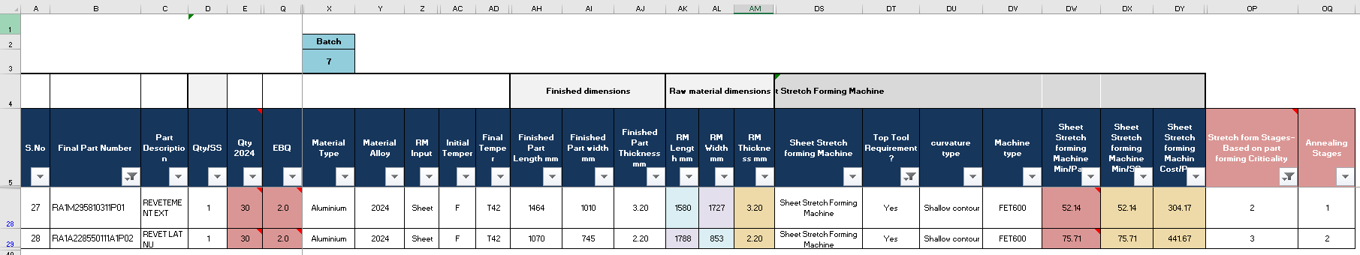
Manufacturing Process Time and Cost Estimation
Technology- Sheet Stretch Forming
Formula in Column DW
=IF($B28<>"",IF(BF28="Make",IF(ISNUMBER(SEARCH("Sheet Stretch Forming Machine",DS28)),(((60*OP28)/($X$3))+(10*OP28+5*OP28+5)*1),0),0),"")
Stretch forming Machine Min/Part= Setup time(60min*No. of SSF stages)/(Batch Qty considered)
+10min(Part Setup on tool)*No. of SSF stages+5Min*(No. of SSF stages)+5min*1(Top Tool Press stage)
Stretch forming Min/SS = Stretch forming Min/Part*(Qty/SS)
Stretch forming Cost = (Stretch forming Min/60) * MHR

Slide 21
Manufacturing Process Time and Cost Estimation
Technology- Extrusion Stretch Forming
Formula in Column EO
=IF($B21<>"",IF(BF21="Make",IF(ISNUMBER(SEARCH("Ext Stretch wrap 3M Triform 28T",EO21)),(30/(MIN(Q21*D21,30))+5+2),0),0),"")
Extrusion Stretch forming Machine Min/Part= Setup time(30min*/(Batch Qty*Qty/SS)+5Min(Part loading)+2min(Stretching)
Extrusion Stretch forming Min/SS = Extrusion Stretch forming Min/Part*(Qty/SS)
Extrusion Stretch forming Cost = (Extrusion Stretch forming Min/60) * MHR

Slide 22
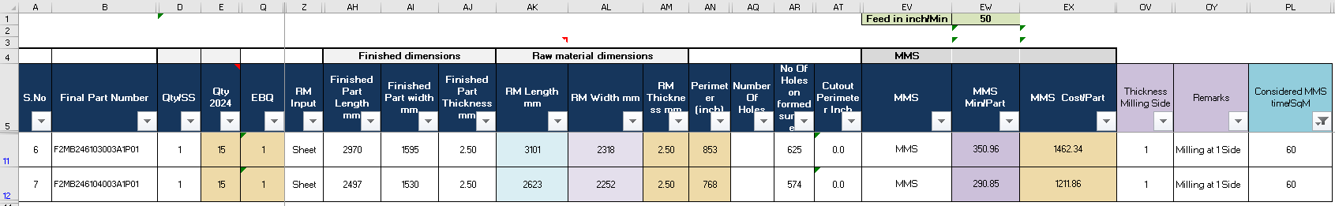
Manufacturing Process Time and Cost Estimation
Technology- MMS(Mirror Milling System)
Formula in Column EW
=IF($B11<>"",IF(BF11="Make",IF(ISNUMBER(SEARCH("MMS",EV11)),(40*OV11/(Q11*D11*5)
+((OV11*(AH11*AI11)/(1000*1000))*PL11)+(AN11)/$EW$1+(4/60)*(AQ11+AR11)),0),0),"")
Extrusion Stretch forming Machine Min/Part= Setup time(40min*No. of Milling Side/(Batch Qty*Qty/SS)
+No. of Milling Side*Part Area*Time per SqM(60min or 45 min)
+ Perimeter/Feed rate in inch/Min(50”)
+(4sec per Hole/60)*(no. of Holes).
MMS Min/SS = MMS Min/Part*(Qty/SS)
MMS Cost per Part = (MMS Min/60) * MHR

Slide 23
Non recurring cost calculation
*NRC-is a one-time or infrequent expense that a business incurs and is not expected to pay again in the future.
*Below are the components of NRC.
*30 $ is the hourly rate for Engineering effort hrs & Tool design hrs
NRC
Soft NRC
FAI
Hard NRC
Tool desgin
Tool fabrication
MOS
Engineering efforts
NC programming
Model +Digitizatian
QA Plan
FAI Plan

Slide 24
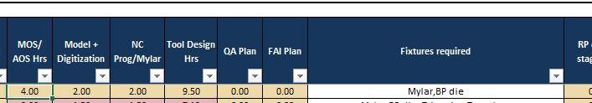
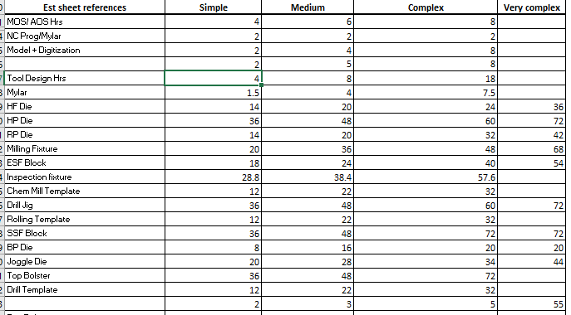
Non recurring cost calculation
MOS hrs, Model+digitization hrs & NC prog hrs are calculated based on the complexity of the part and values taken from “Input sheet”, refer below table.
The Tool design hrs will be calculated upon identifying the type of tools required based on the part in the column”Fixtures required”.
QA Plan and FAI Plan will be zero, as it will be provided in the quality workout, and is considered in the business case.

Slide 25
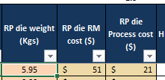
Non recurring cost calculation
* Rubber press tool cost calculation
* No of tools will be calculated based on the number of stages mapped in the “Rubber Press No of stages”.
*RP Die weight(Kgs)- (RM Length in mm+100mm)*(RM Width in mm+100mm)*(3”*25.4mm)*2.85/10^6
Note
2.85 g/cm3 is density of aluminum for weight calc.
And 100mm is the allowance for Tool RM.
*RP die RM cost= RP Die weight(Kgs) * 8.5
Note- 8.5 is $/Kg(is the standard derived upon the agreement with CFT team)
*RP die process cost = RP Die weight(Kgs) * 0.3 * 12
Note- 0.3 is 30% material removal and 12 is $/kg

Slide 26
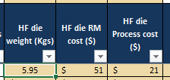
Non recurring cost calculation
* Hand form tool
* No of tools will be calculated based on the Hand forming mapped in the “Hand forming.
*HF Die weight(Kgs)- (RM Length+100)*(RM Width+100)*(3*25.4)*2.85/10^6
Note
2.85 g/cm3 is density of aluminum for weight calc.
And 100mm is the allowance for Tool RM.
*HF die RM cost= HF Die weight(Kgs) * 8.5
Note- 8.5 is $/Kg(is the standard derived upon the agreement of CFT team)
*HF die process cost = HF Die weight(Kgs) * 0.3 * 12
Note- 0.3 is 30% material removal and 12 is $/kg

Slide 27
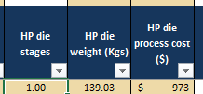
Non recurring cost calculation
*Hydraulic press tool cost calculation
* No of tools will be calculated based on the number of stages mapped in the “Hydraulic press tools.
*HP Die weight(Kgs)- (RM Length+150)*(RM Width+150)*(15”*25.4)*7.85/10^6
Note
7.85 g/cm3 is density of Steel for weight calc.
And 150mm is the allowance for Tool RM.
*HP die process cost = HF Die weight(Kgs) * 7
Note- 7 is $/kg for complete tool including raw material cost.

Slide 28
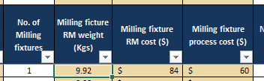
Non recurring cost calculation
*Milling fixture cost calculation
* Enter number of milling fixtures required manually in column”No of milling fixtures”.
*Milling fixture RM weight(Kgs)- (RM Length+100)*(RM Width+100)*(5”*25.4)*2.85/10^6
Note-
1). 2.85 g/cm3 is density of aluminum for weight calc.
And 100mm is the allowance for Tool RM.
2). For parts having length > 1.0M ,Consider milling fixture height as 4 inch(Check forming height before considering 4 inch)
3). Milling fixture used for stretch forming part, substitute the RM length & RM width to Formed length, Formed Width & height respectively and change the allowance to 50 and multiply the whole with a 0.6 factor.
*Milling fixture RM cost= Milling fixture weight(Kgs) * 8.5
Note- 8.5 is $/Kg(is the standard derived upon the agreement of CFT team)
*Milling fixture process cost = Milling fixture weight(Kgs) * 0.3 * 20
Note- 0.3 is 30% material removal and 20 is $/kg

Slide 29
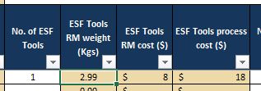
Non recurring cost calculation
*ESF Block cost calculation
* Enter number of ESF tools required manually in column ”No of ESF tools”.
*ESF Tools RM weight(Kgs)- (Formed length+50)*(Formed Width+50)*(6*25.4)*7.85/10^6
Note-7.85 is density of Steel for weight calc
And 50mm is the allowance for RM.
*ESF Tools RM cost= ESF Tools RM weight(Kgs) * 2.73
Note- 2.73 is $/Kg(is the standard derived upon the agreement of CFT team)
*ESF Tools process cost = ESF Tools RM weight(Kgs) * 0.3 * 20
Note- 0.3 is 30% material removal and 20 is $/kg

Slide 30
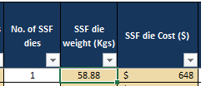
Non recurring cost calculation
*Stretch forming die & SSF Top die cost calculation
* Enter number of Stretch forming die tools required manually in column ”No of SSF dies”.
*SSF die weight(Kgs)- (Formed length+500)*(Formed Width+100)*(Formed height+(300-Formed height)*7.85/10^6 * 50%
Note-7.85g/cm3 is density of Steel for weight calc, keeping 300 is the minimum height required for tool & 50% factor
And 500mm & 100mm is the allowance for RM.
Add 50mm extra in height if the formed height is more than 280mm.
*SSF die cost= SSF die weight(Kgs) * 11
Note- 11 is $/Kg(is the standard derived upon the agreement of CFT team)

Slide 31
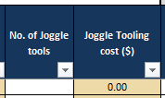
Non recurring cost calculation
*Joggle tools cost calculation
* Enter number of joggle tools required manually in column ”No of Joggle tools”.
*Joggle tooling cost= (250*250*100*2.85/10^6)*8.5*No of joggle tools+(250*250*100*2.85/10^6)*0.4*20*No of Joggle tools
Note- 250mm is the length & Width of joggle tool, 100mm is height of Joggle tool and 2.85 is the density of Aluminium for weight Calc,
0.4 is the material removal and 20 is the $/kg.
(Length,width & Height of the tool to be updated based on the complexity)

Slide 32
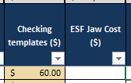
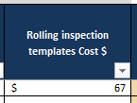
Non recurring cost calculation
*Checking template-
It is mandatory for all sheet metal parts for flat pattern inspection.
* ESF Jaw cost- Cost of 1- pair ESF jaw is 8000$ and need to be divided by the number of same sections(Shape) in the package that has ESF forming.
*Rolling inspection template
Enter the cost of the Rolling inspection template as per the below.

Slide 33

Non recurring cost calculation
*Drill Jig tool cost calculation
*Identify the hand drill requirement in process planning,
Copy the cell above the drill jig cost $ and paste it the respective cell for cost.
Drill jig cost $- ((RM Length+100)*(RM Width+100)*(3*25.4)*2.85/10^6)*8.5+((RM Length+100)*(RM Width+100)*(3*25.4)*2.85/10^6)*0.3*12
Note-3 is in inches and is multiplied by 25.4 for mm conversion and 2.85 is density of aluminum for weight calc
And 100 is the allowance for RM.
8.5 is $/Kg(is the standard derived upon the agreement of CFT team)
0.3 is 30% material removal and 12 is $/kg

Slide 34
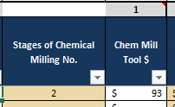
Non recurring cost calculation
*Chemical milling template cost calculation
*Identify and map the number of stages required in “stages of chemical milling no.”.
Chemical milling template cost $- ((Finish length)*(Finish width)*(1*25.4)*2.85/10^6)*8.5*stages of chemical milling no+
((Finish Length)*(Finish Width)*(1*25.4)*2.85/10^6)*0.4*20*stages of chemical milling no
Note-1 is in inches and is multiplied by 25.4 for mm conversion and 2.85 is density of aluminum for weight calc
8.5 is $/Kg(is the standard derived upon the agreement of CFT team)
0.4 is 40% material removal and 20 is $/kg

Slide 35
Thank You

